Slide 1
Mother’s Day
Clever Caterpillars

Slide 2
What Is Mother’s Day?
Mother’s Day is a time when children thank their moms.
Children often give their mom’s a gift, a card, some flowers or lots of kisses and cuddles!

Slide 3
How Can We Say ‘Thank You’
We can thank our moms for all they do in lots of different ways:
making them a card
giving them a cuddle and a kiss
buy or make them a gift
pick some flowers in the garden
help to clean and tidy the house
What could you do for your mom?

Slide 4
Help Mom Around The House
This is how we can help our moms at home
Tidying up your toys
Making your bed
Folding the washing
Sweeping the floor

Slide 5
Poems
Dear Mommy
You sew my buttons on my clothes,
You give me a tissue for my nose.
You make good things for me to eat,
You buy me sweets for a treat.
You wash my clothes and mend my socks,
Dear Mommy, I love you lots and lots!
Here is a Flower
Here is a flower,
For a very special day,
Just for you on Mother’s Day.
Many hugs and kisses, too,
Each one says that I love you!

Slide 6
Mother’s Day Crafts
This is a beautiful flower card.
All you need to do is use different
coloured paints to paint your handprints.
If you don’t have paint you can trace
your hand and then colour it in.
Then you need someone to help you cut
them out. Use your finger to paint some
green flower stems or cut out some.
Stick your handprints next to each stem
to create a flower.
If you have some ribbon at home you can
tie a bow and stick it at the end of your
bunch of flowers.
Get an adult to write, “Happy Mother’s Day”

Slide 7
Mother’s Day Crafts
Get some coloured paper and
trace your hand. Cut out your
handprints and then cut out
some green stems. Stick your
handprints at the end of the
stems. Trace your arm and hand
and get help cutting that out.
Stick your arm and hand over
the stems so it looks like you
are holding a bunch of flowers.

Slide 8
Mother’s Day Crafts
Draw a heart in the middle
of a page. Dip your fingers
in different colours of paint.
Fill the page with your fingerprints
around the heart. Ask an adult to
write you a message below the
picture or print it out for you.
“My dirty little fingerprints I’ve
left on every wall, and on the
drawers and table tops, I’ve really
marked them all. But here are some
that won’t rub off, I made them
just for you, because I’m thankful
for a mom who loves me like you do.”

Slide 9
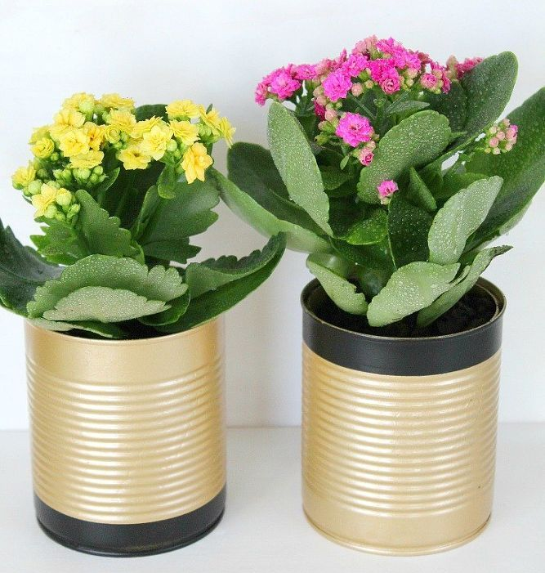
Mother’s Day Crafts
Empty a tin can and get an adult
to clean it properly for you
(it is very dangerous for you to do.)
Once it is clean and dry, you can
paint it or spray paint it. Fill it up
with some sand/soil and pick some
flowers to plant in it. Your mom will
love her homemade flower pot.

Slide 10
Make Mom A Breakfast
You can make mom a yummy breakfast!
Here are some ideas:
egg, bacon and toast
yoghurt and museli
fruit and yoghurt
pancakes or crumpets
coffee, tea or fruit juice

Slide 11
Mother’s Day Coupons
Spoil your mom with these lovely coupons!

Slide 12
Mother’s Day Coupons
Spoil your mom with these lovely coupons!

Slide 13
Mother’s Day Story
https://www.youtube.com/watch?v=fC4GN0sEJi8

Slide 14
Songs and videos
https://www.youtube.com/watch?v=MYqFPa1mrXo
https://www.youtube.com/watch?v=ca9rptz0mDI
https://www.youtube.com/watch?v=frYfZYeBO4k
https://www.youtube.com/watch?v=Km4vp3Z7hPM
Happy Mother’s Day Song
I Love You Mommy Song
Hugs And Kisses Song
Mother’s Day – Kid Interviews

