Slide 1
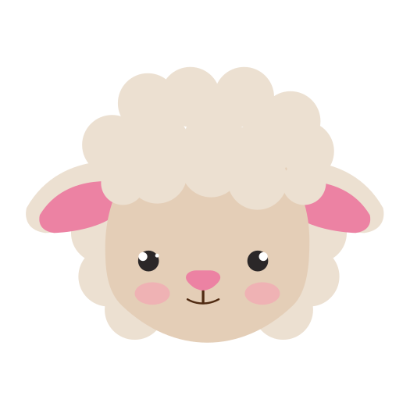
Little Lambs
WEEK 1

Slide 2
THEME: GET CREATIVE AT HOME

Slide 3
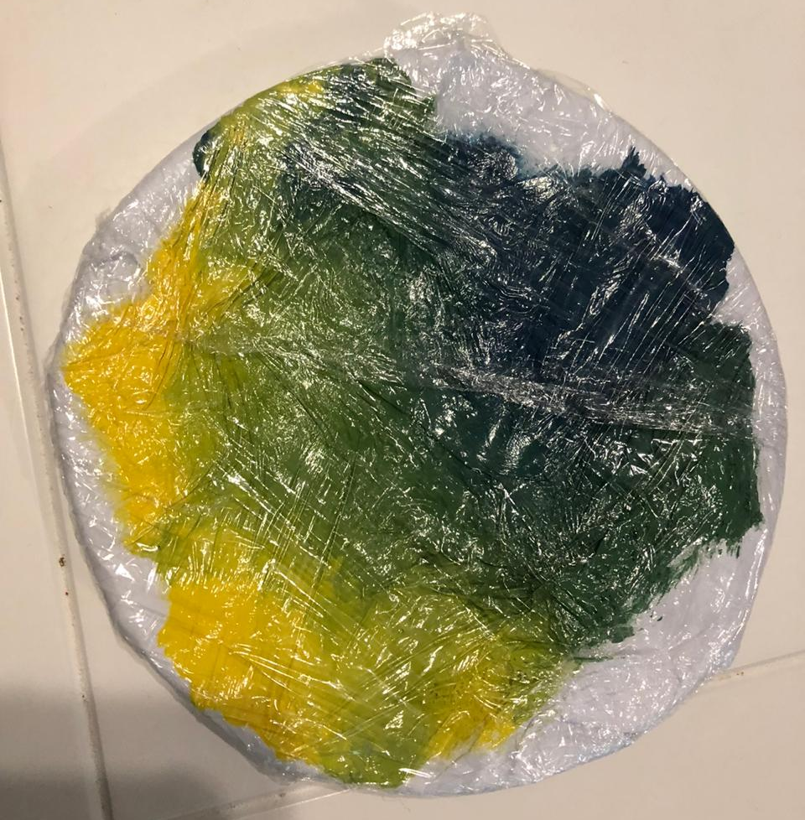
1.COVER A PLATE IN PAPER
2.PAINT THE PAPER - YELLOW AND BLUE
3.COVER THE PLATE IN
CLING WRAP. ALLOW LITTLE FINGERS TO MIX TOGETHER TO MAKE COLOUR GREEN!
OR

Slide 4
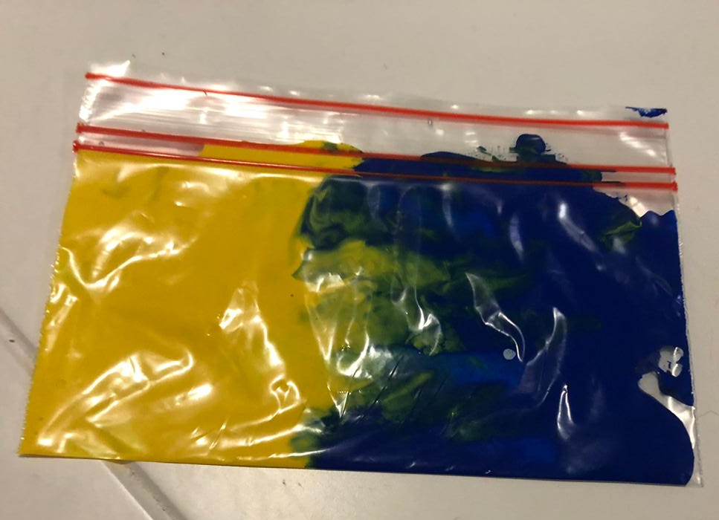
FILL A SMALL PLASTIC ZIP-LOCK BAG WITH YELLOW AND BLUE PAINT.
SIMILARLY THE BABIES CAN MIX AND CREATE, STRENGTHENING THEIR FINGER MUSCLES.

Slide 5
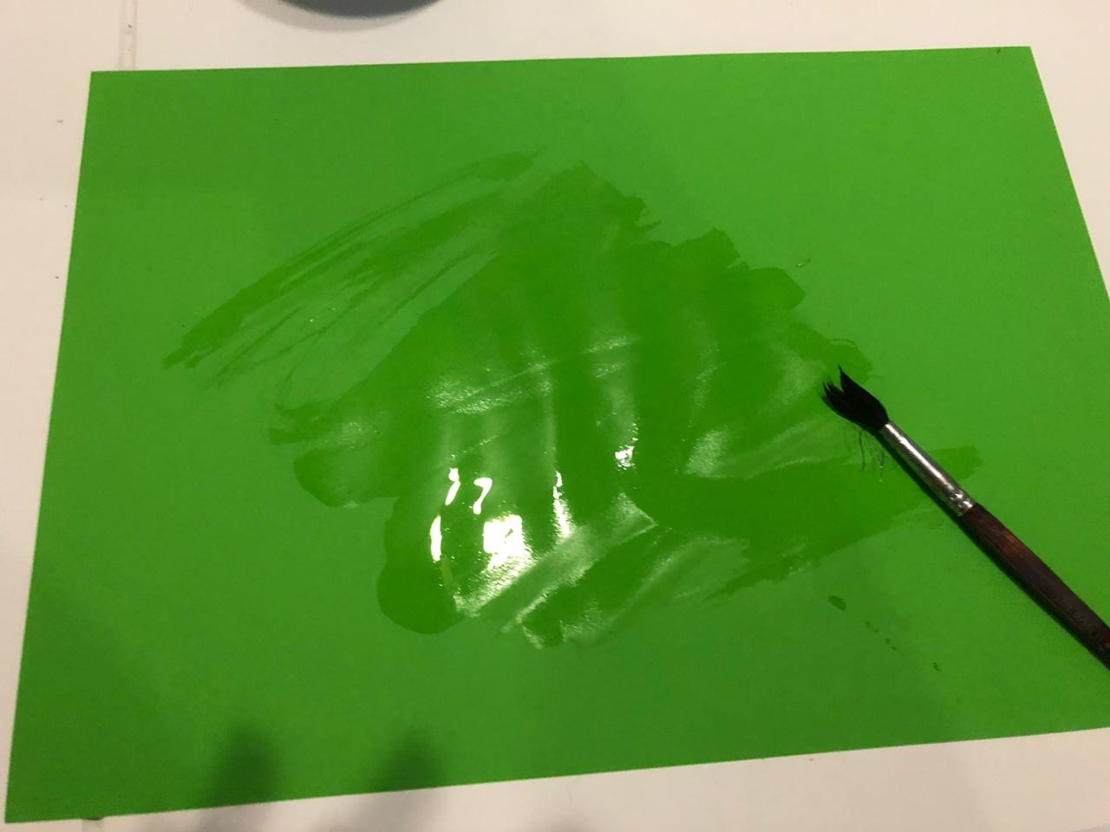
PAINT A COLOURED PIECE OF PAPER WITH WATER.
THIS LETS YOUR LITTLE ONES FEEL CREATIVE
(WITHOUT THE MESS!)
AGAIN STRENGTHENING THEIR LITTLE FINGER MUSCLES.

Slide 6
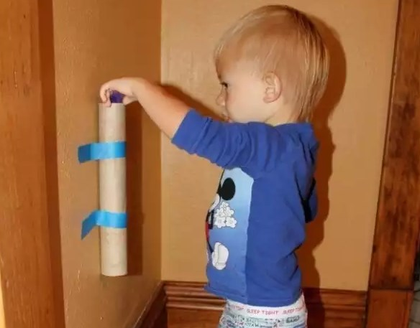
STICK A TOILET ROLL OR ROLLER TOWEL ONTO THE WALL USING PRESTICK
TEACH YOUR BABIES TO DROP SMALL OBJECTS THROUGH THE SMALL SPACE
THIS IMPROVES HAND - EYE COORDINATION

Slide 7
HALF FILL AN EMPTY WATER BOTTLE WITH DRY RICE
=
*SHAKE TO MAKE
A SONG *

Slide 8
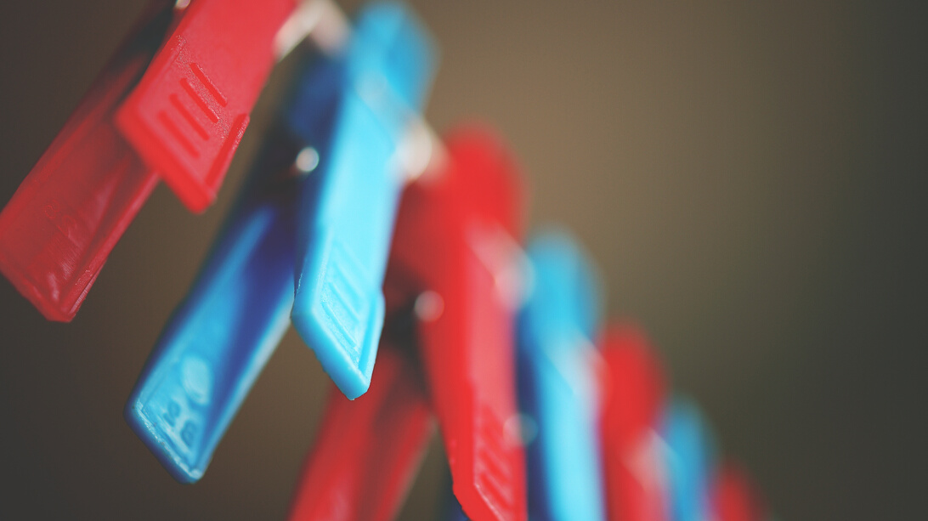
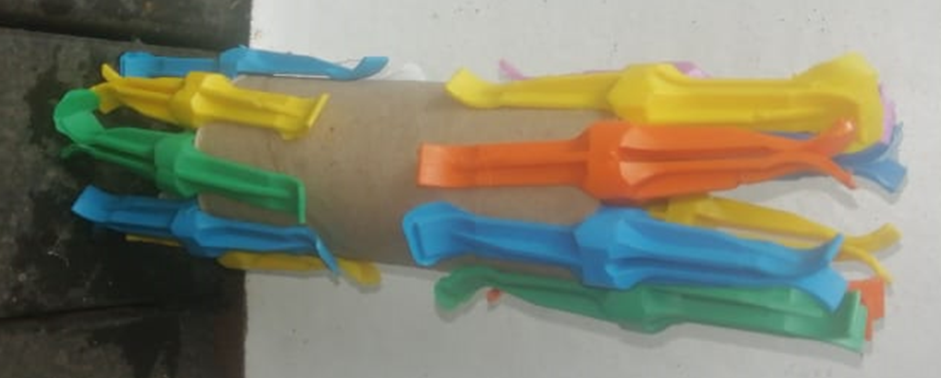
FIND AN EMPTY TOILET ROLL OR ROLLER TOWEL
PEG COLOURFUL PEGS ONTO THE END OF THE EMPTY TOILET ROLL
LET YOUR BABY PULL OFF THE COLOURFUL PEGS -STRENGTHENING LITTLE FINGER MUSCLES

Slide 9
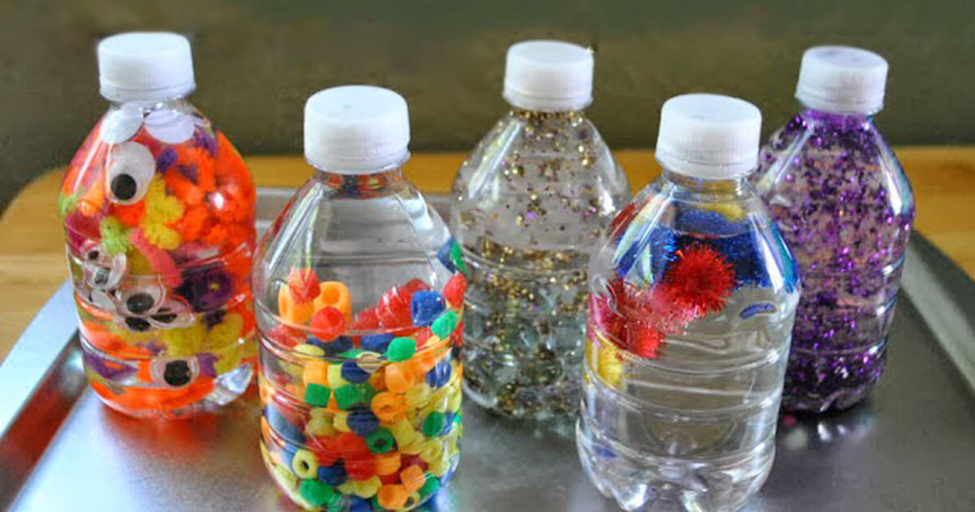
FILL THE CONTAINER WITH BRIGHT OBJECTS YOU FIND AROUND THE HOUSE
FILL A TRANSPARENT CONTAINER WITH WATER
LET YOUR BABY SHAKE THE BOTTLE TO SEE THE OBJECTS SPARKLE.

Slide 10
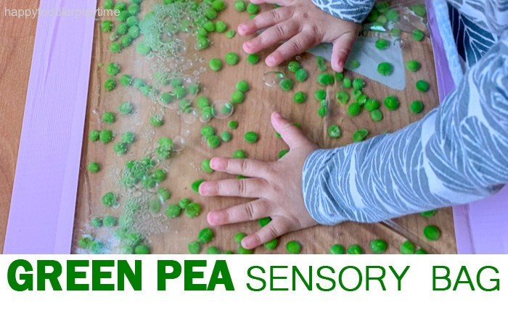
FILL A ZIP LOCK BAG WITH FROZEN GREEN PEAS
ALLOW THE GREEN PEAS TO DEFROST
LET YOUR BABY SQUISH THE GREEN PEAS WITH THEIR FINGERS

Slide 11
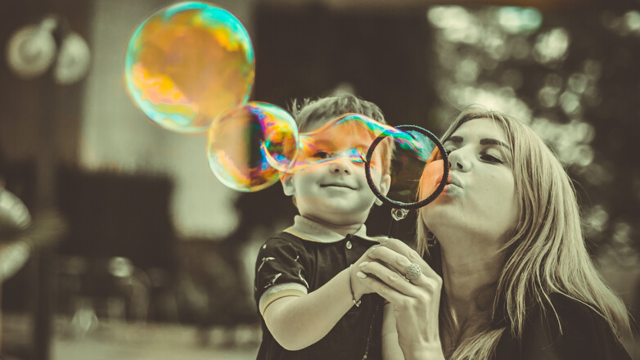
BLOW BUBBLES
SO THAT YOUR BABY CAN POP THE BUBBLES
DEVELOPING GOOD HAND - EYE
COORDINATION

Slide 12
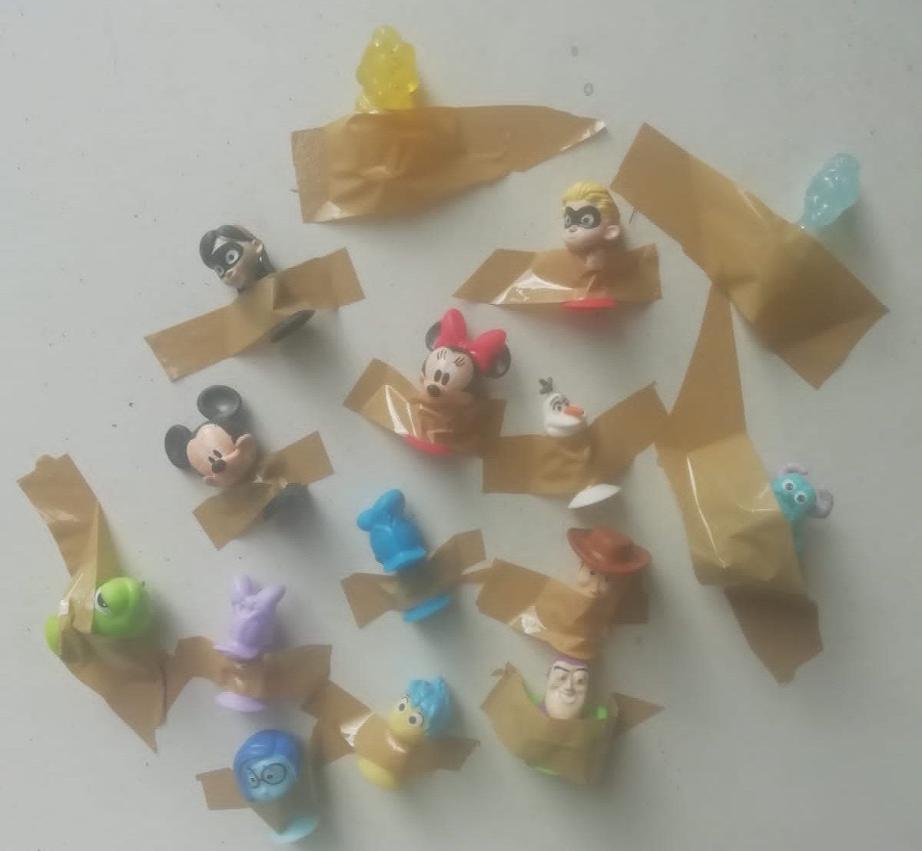
TAPE TOY ANIMALS OR BLOCKS TO A STABLE SURFACE
LET YOUR BABY PULL OFF THE TAPED TOYS
THIS ACTIVITY STRENGTHENS THE FINGER MUSCLES AND DEVELOPS HAND-EYE COORDINATION

Slide 13
SENSORY RICE BOWL
FILL A LARGE PLASTIC BOWL WITH DRY RICE
HIDE SMALL TOYS IN THE RICE
LET YOUR BABY DIG FOR THE TREASURE

Slide 14
INTERACTIVE SONGS
https://youtu.be/hlzvrEfyL2Y
https:youtu.be/3Vfmu5jXJ18
https://youtu.be/pPrwQ9L42cs
https://youtu.be/RvgnuPL9x-s
https://youtu.be/bYFvMJ_jtZ4
https://youtu.be/r3S1FwlbN-4

