Slide 1


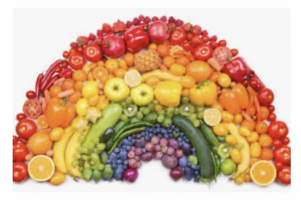
FRUIT AND VEGETABLES
WEEK 11
LITTLE LAMBS

Slide 2
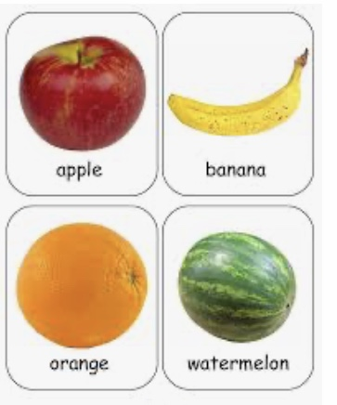

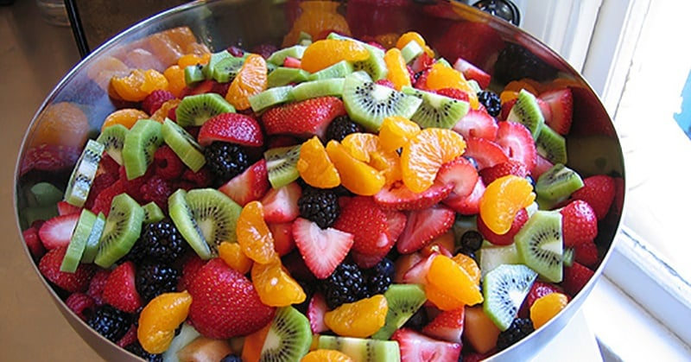
FRUIT
PRESS HERE

Slide 3
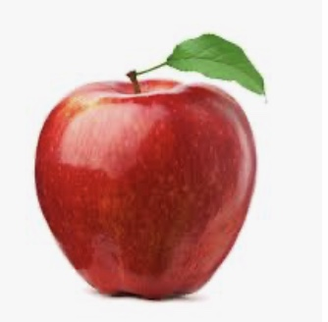

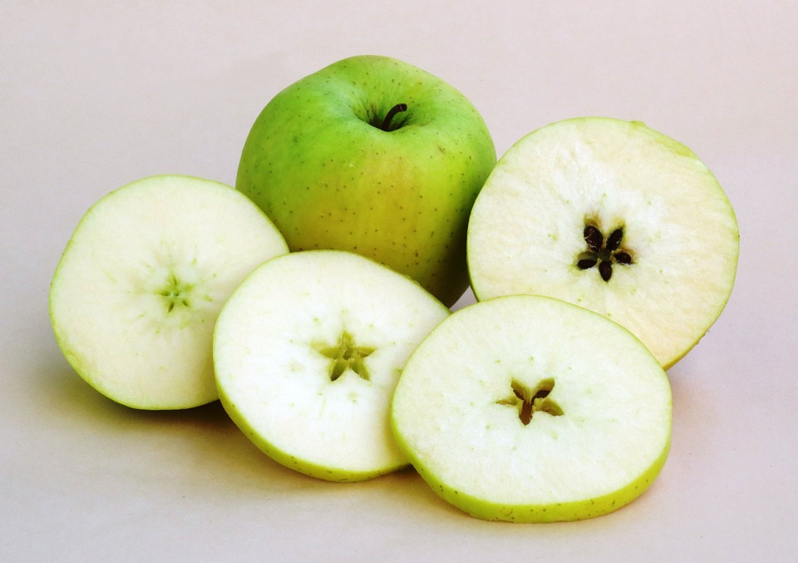
RED APPLE

Slide 4
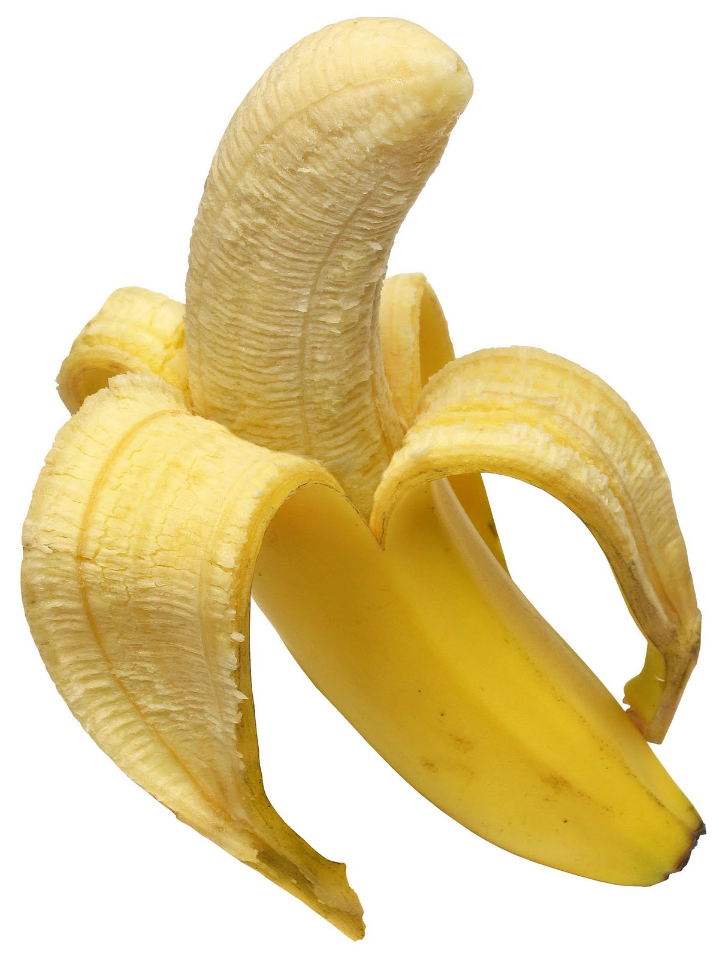
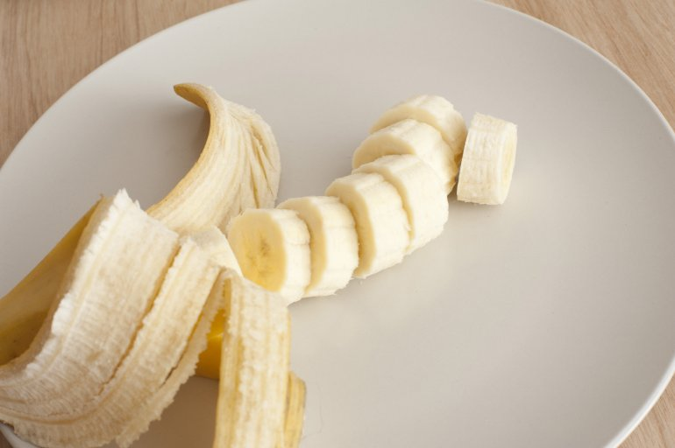
YELLOW BANANA
This Photo by Unknown Author is licensed under CC BY

Slide 5
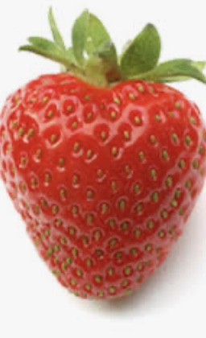
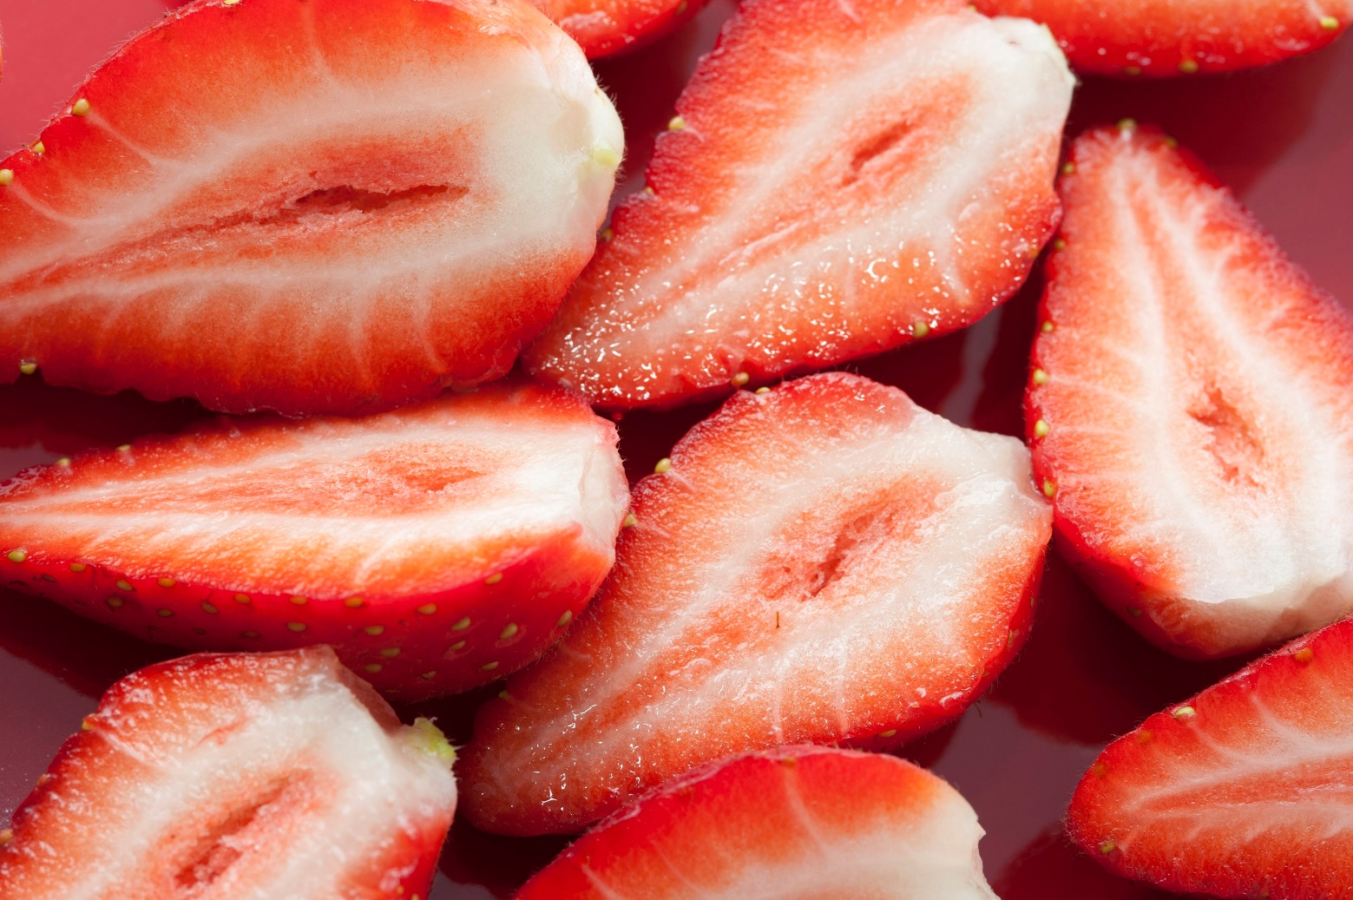
RED STRAWBERRY

Slide 6
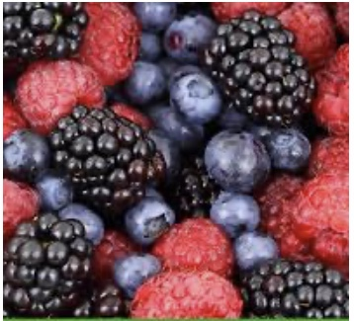
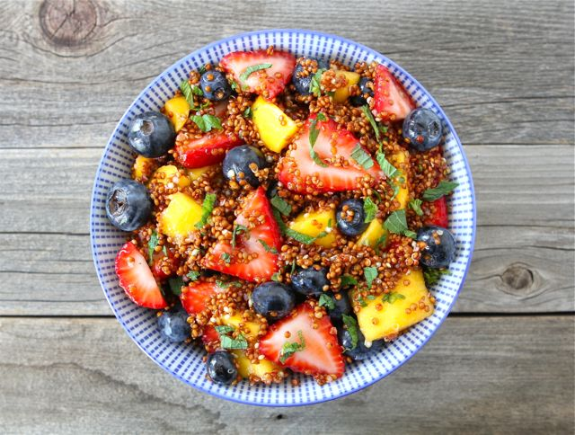
BERRIES

Slide 7
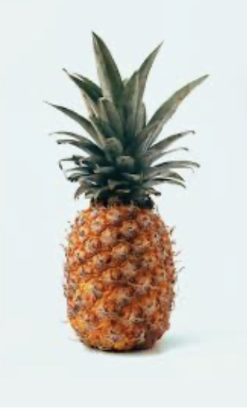
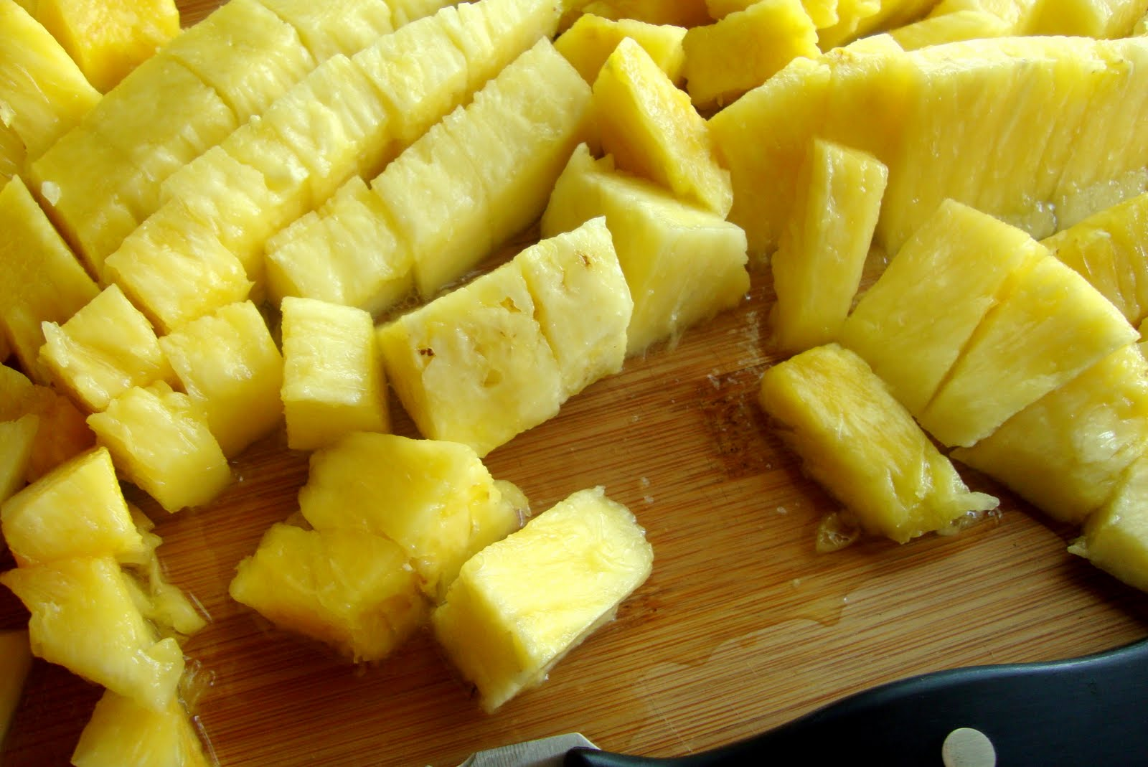
YELLOW PINEAPPLE

Slide 8
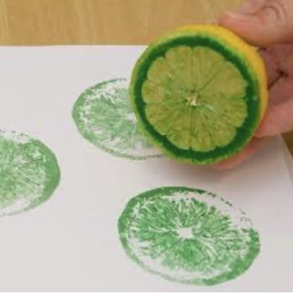
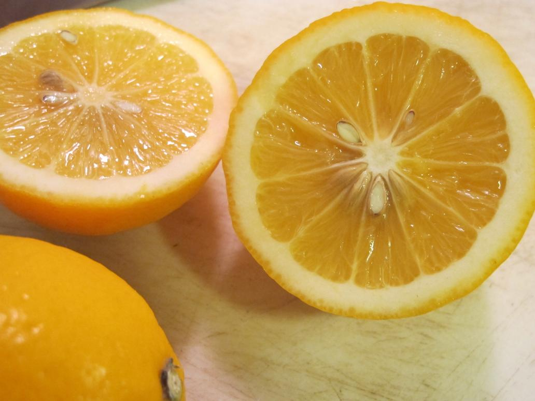
YELLOW LEMON

Slide 9
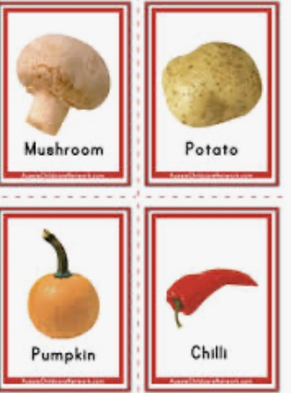
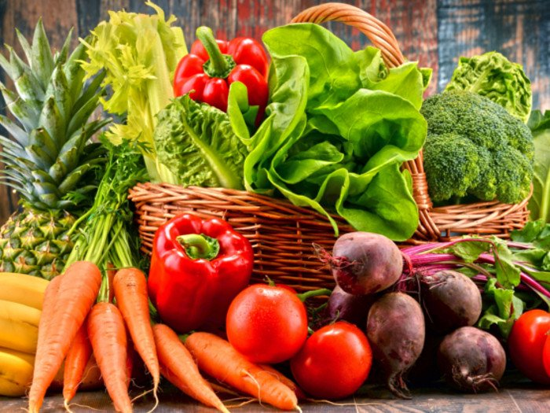
VEGETABLES

Slide 10
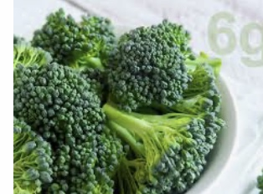



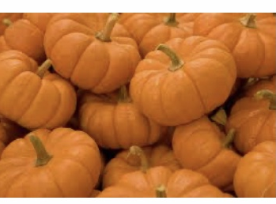

GREEN BROCCOLI AND ORANGE PUMPKIN

Slide 11
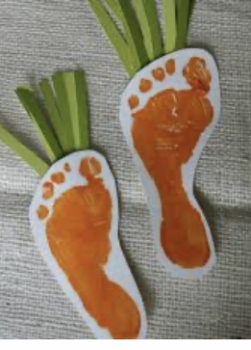
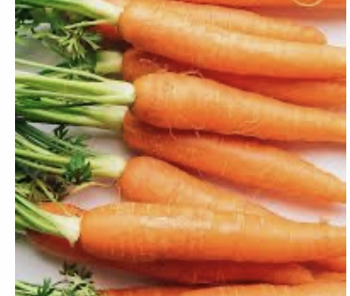
ORANGE CARROTS
CARROT ART ACTIVITY

Slide 12
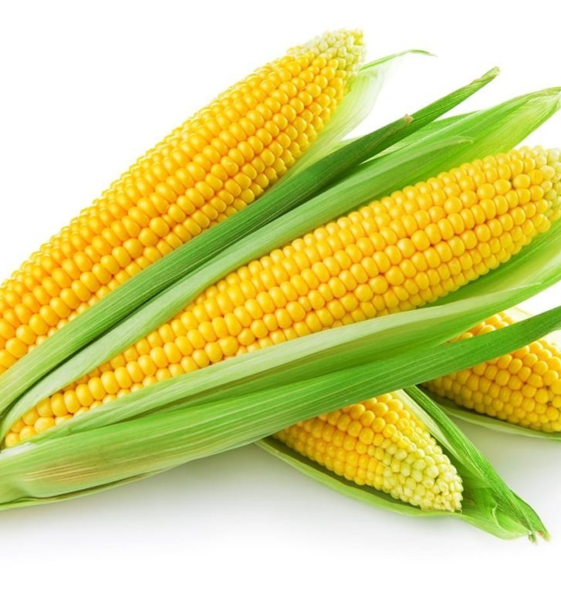
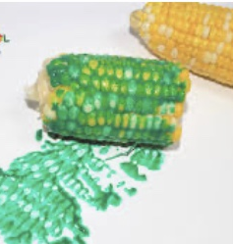
YELLOW CORN

Slide 13
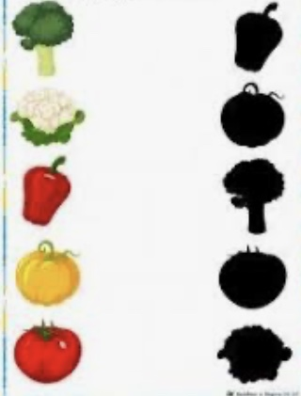
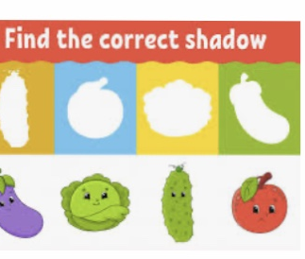

Slide 14
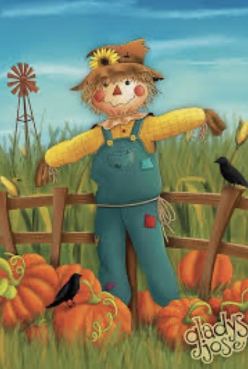
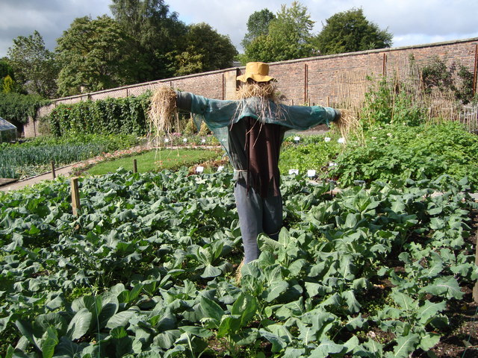
SCARECROW

Slide 15
SONG LINKS:
https://www.youtube.com/embed/bAhlYxS-6gc
https://www.youtube.com/embed/co4ieJg0ivQ
https://www.youtube.com/embed/tnGBx9ydWcQ
STORY LINKS:
https://www.youtube.com/embed/ysPxSHHE8Lg

