Slide 1


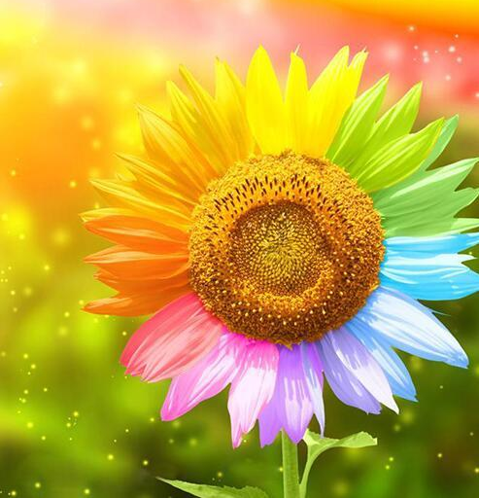

Slide 2

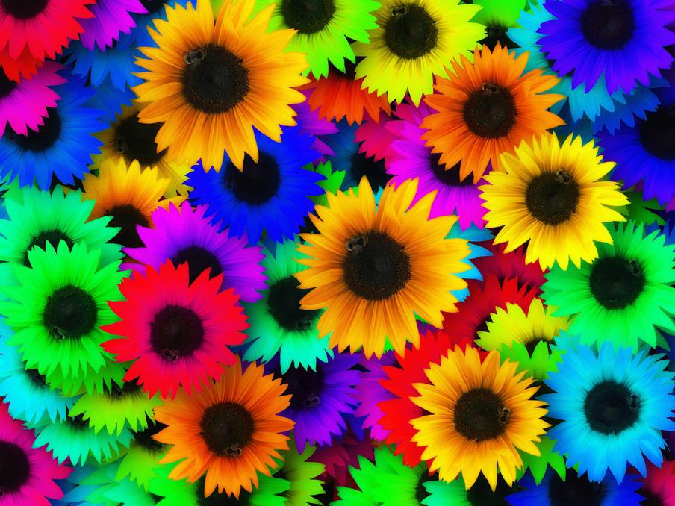

Slide 3

Health
Music
Sunshine
Laughter
Family
Teachers
Nature
Home
Food
Friendships
Healing
Kindness
Water

Slide 4
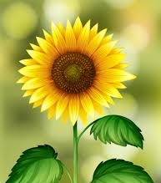

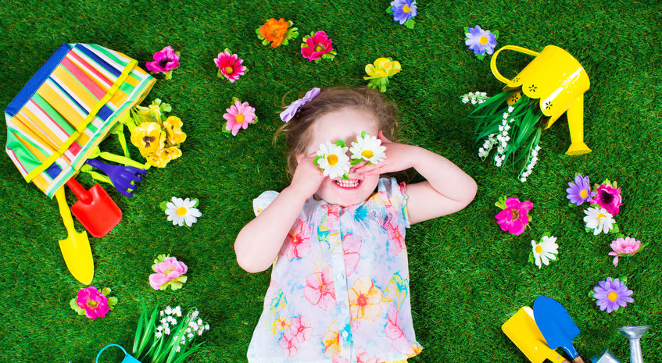
Please listen
Hello Growing Minds Friends,
I hope that you are enjoying seeing your teacher’s face again on the videos.
When we come back to school, we are going to grow a ‘I am Grateful for’ garden. Please can you grow your very own plant at home and choose a word to describe what you are grateful for. Don’t forget to bring your plant on your first day back at school.
Happy planting!

Slide 5
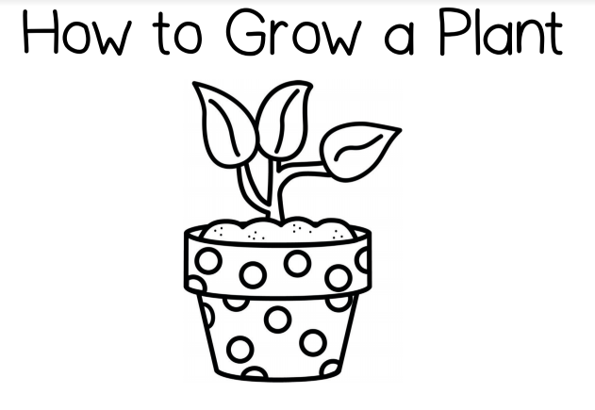
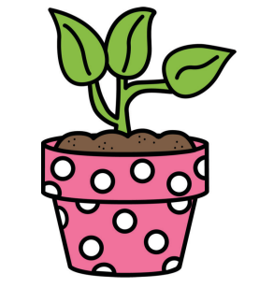

Slide 6
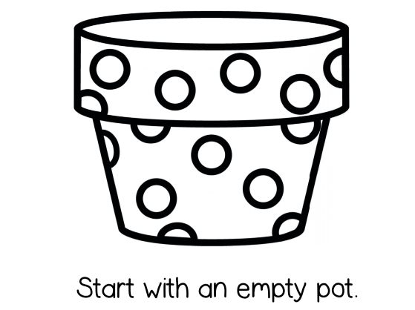

Please ask Mom or Dad to write your chosen ‘I am grateful for’ word on your pot for everyone to see.

Slide 7
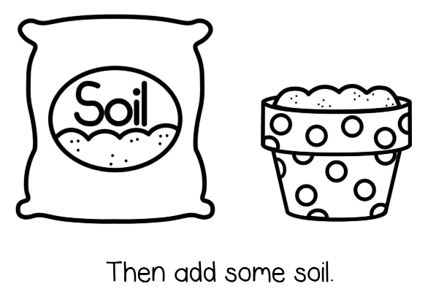



Slide 8
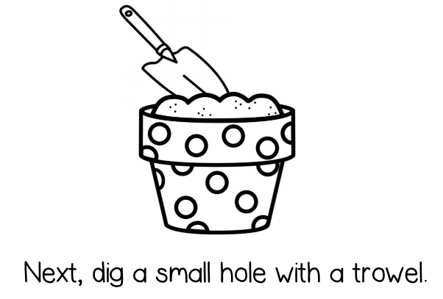


Slide 9
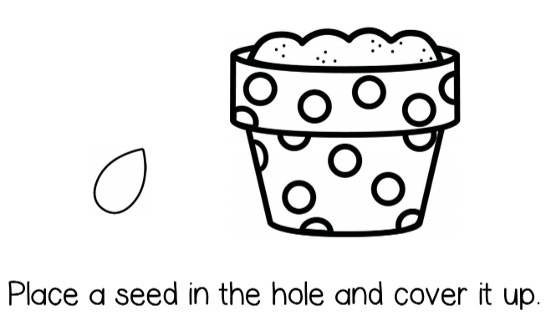

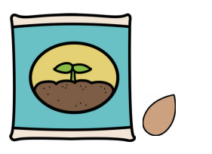

Slide 10
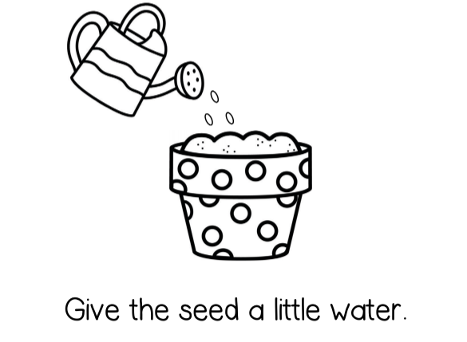

Slide 11
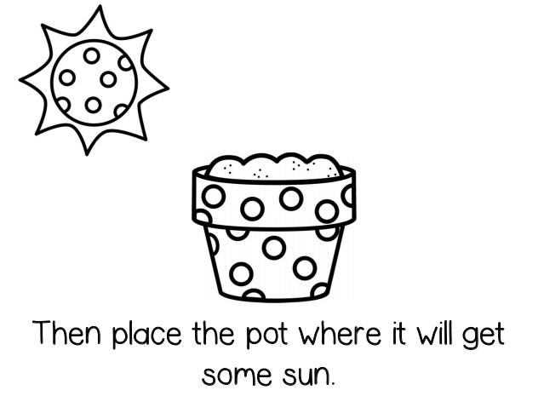

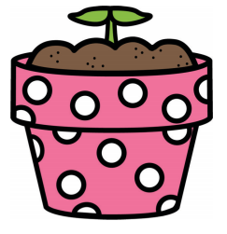

Slide 12
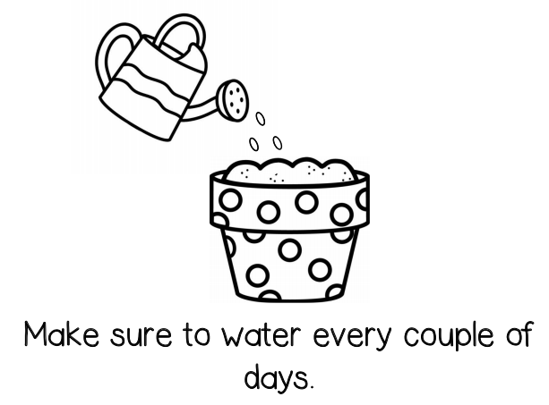

Slide 13
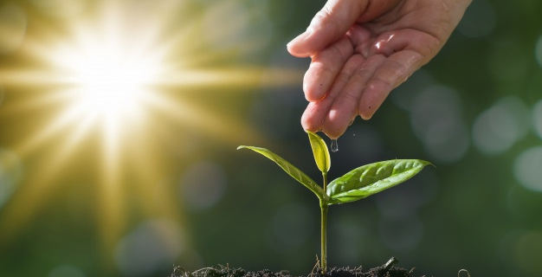
We cannot wait to see your amazing plant.
Love you lots!

