Slide 1
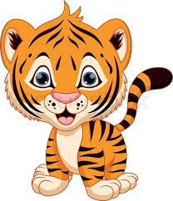
Welcome
Terrific Tigers

Slide 2
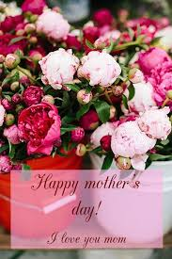
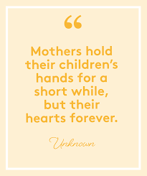
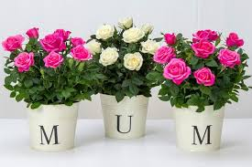
HAPPY MOTHER'S DAY♡♡♡

Slide 3
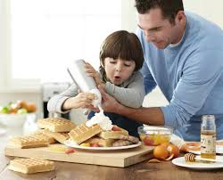
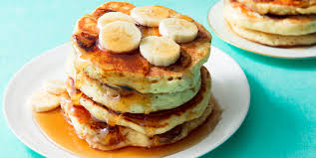
Mom gets breakfast in bed ♡☺😊
Let's start by making mum delicious pancakes!!!
You can follow this recipe:
Ingredients
* 1 cup self raising flour
* 2 eggs
* 30ml oil
*A quarter cup sugar
* A quarter cup milk
Method:
Start by mixing the eggs in a bowl. Add in the oil and milk.
In another bowl add your flour and sugar and mix together. Gradually add in the egg,milk and oil mixture and stir together.
Once you have your batter, heat up a pan and pour a little of the batter to make your pancakes.
Get Dad or someone elder to help you in the kitchen. Serve to Mom with a cup of coffee or tea. If mum doesn't eat pancakes make her favourite breakfast meal.

Slide 4
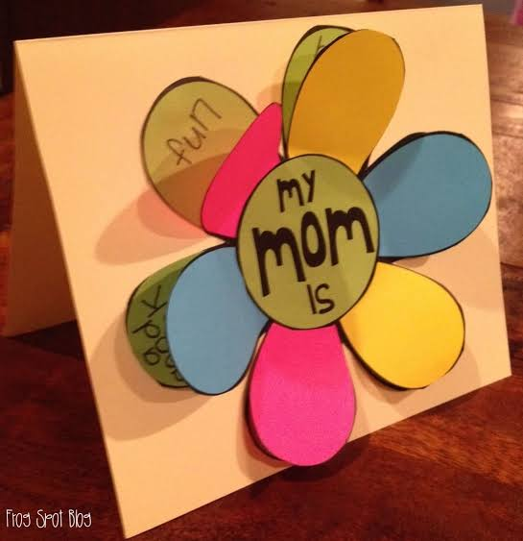
♡Why I love Mom craft♡
Press play to watch my video on how to make this for Mom.

Slide 5
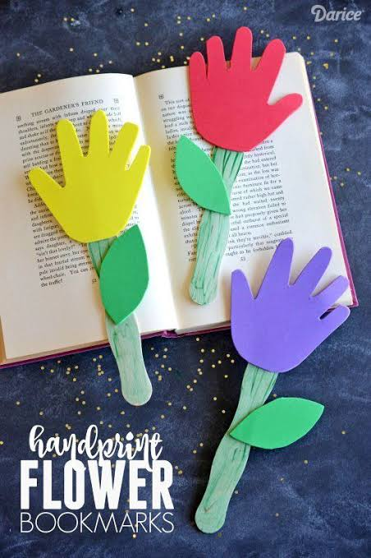
♡A Handprint Bookmark♡
What will we need:
• Glue
• Paint
• Cardboard or paper (White or Colour)
• An ice cream stick
How to make this:
• Start by painting the ice cream stick and set aside to dry.
• Whilst the the ice cream stick is drying, trace out your handprint and a leaf. You can colour this in or use colour paper.
• Using the glue, stick them onto the ice cream stick (As you see in the picture)
• At the back you can write 'I love you Mom♡'

Slide 6
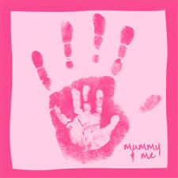
♡A craft to do with Mom♡
A simple yet memorable craft.
You will need a page and paint.
Start by painting Mom’s hand and then yours. Mom puts down her handprint first and then you go next over Mom’s. At the bottom right corner you can get Mom to write 'Mother’s Day 2020'

Slide 7
♡A video for Mom: Mother’s Day♡
Highlighy, copy and paste this into your internet browser to watch the video.
https://youtu.be. be/MYqFPa1mrXo

Slide 8
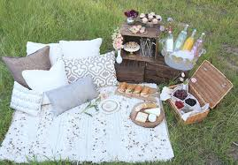
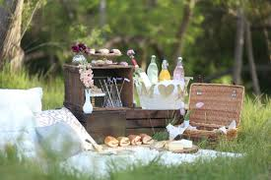
♡Let's have a picnic with Mom♡
Get some snacks from the house and set up a picnic spot for Mom and you.
Spend some quality time together giving Mom lots of love and cuddles.

Slide 9
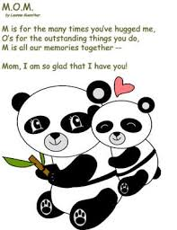
♡Special messages for you special Moms♡

Slide 10
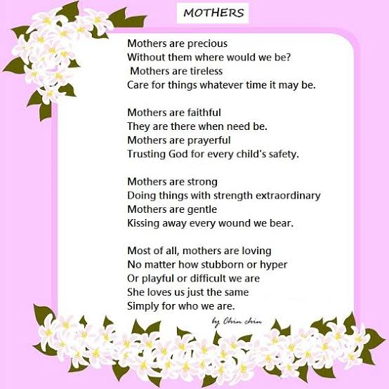
A special message to all you phenomenal Terrific Tiger Moms...
Happy Mother's Day to my beautiful Terrific Tiger Mom's. Sending you lots of love from Tanya ♡.

