Slide 1
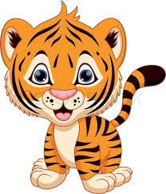
Welcome
Terrific Tigers
Week 1

Slide 2
Press play to listen to the voice recording for our Morning Ring. Get up on your feet and sing along
It's Morning Ring Time with the Terrific Tigers...
Let's do our Morning Ring with Aunty Tanya

Slide 3
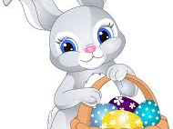
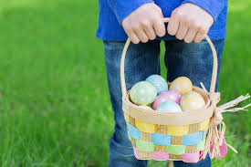
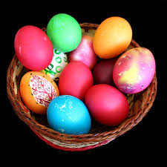
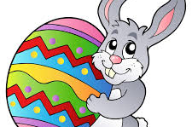
Theme
of the week
Easter

Slide 4
Gross Motor Activities
Please highlight, copy and paste these links into your Internet browser, to access these videos. Lets sing along!!
Do the Hokey Pokey
Head, Shoulders, Knees and Toes
https://youtu.be/YzSJBowPECY
https://youtu.be/ZanHgPprl-0

Slide 5
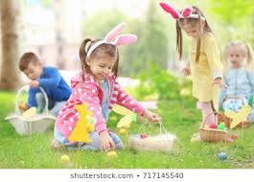
Easter Egg Hunt
Mom and Dad…
You can hide their treats...
• Outside near a tree
• In their room, under the
pillow
• Behind the couch
● Use coloured paper as markers to place them near the area the treat is hidden. This will help them to look around this area to find their treat.
Hide easter treats in the kids rooms or outside. Give them clues for them to go and find their treat.

Slide 6
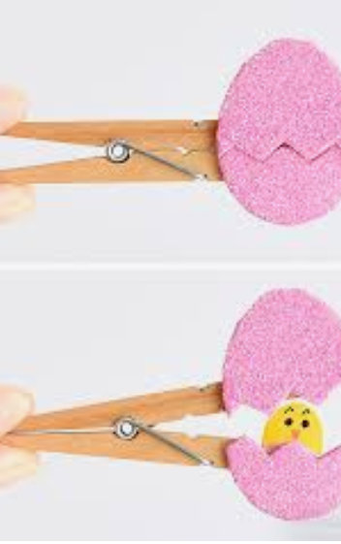
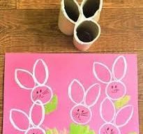
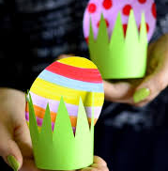
Creative
Art Activities
Here are 3 creative activity ideas. No need to do all of them, just choose one that you have materials for.
Happy making!
Peg and egg
Easter bunny toilet roll stamp
Easter Egg in grass
using coloured paper

Slide 7
Creative Art Activities -
Materials Needed
Easter Egg in Grass
Easter bunny toilet roll stamp
Peg and egg
•paper
• scissors
•crayons
• Glue
Cut out a grass and an egg template. Allow the kids to colour and decorate as they want. Glue the grass at one end to close and place the egg inside.
• 3 toilet roll holders
•paint
•paper
• Scissors
Start by cutting the toilet roll holder and stick together as seen in the picture, to create a bunny. Then, dip in paint and place on paper as a stamp. Allow the kids to decorate their easter bunny.
• A peg
• Cardboard
•Scissors
• Crayon
Cut an eggshell template and a chick as seen in the picture. Allow the kids to colour as they want and stick it onto the peg.

Slide 8
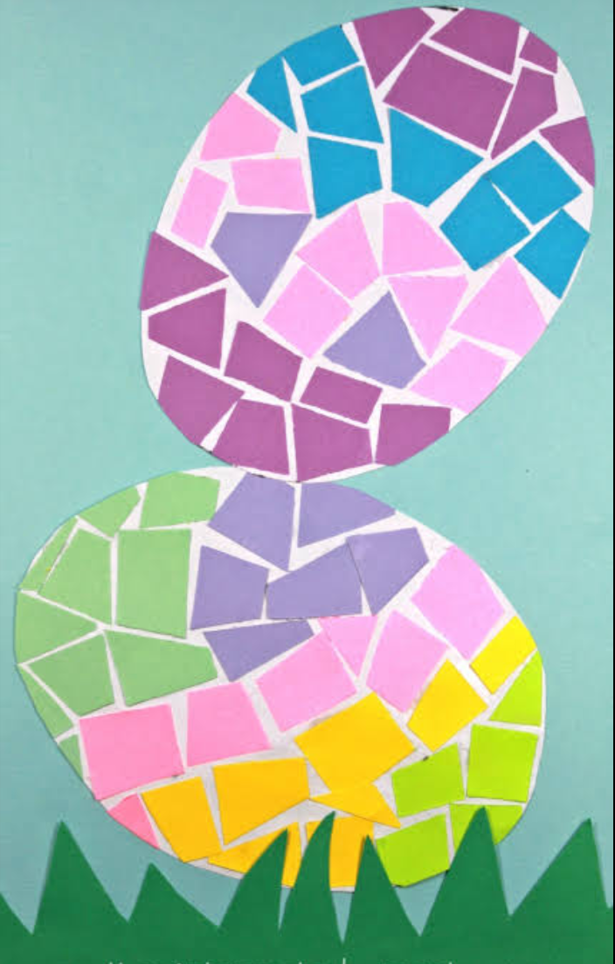
Fine motor activities
Extra fine motor skills activities:
1. Cutting - draw a straight line on a page and get learners to cut along the line.
2. Bead Threading - using a string allow learners to thread items such as beads, macaroni, etc.
Paper Tearing - draw a template of an egg as seen in the picture. Using different coloured paper, allow children to tear apart and stick over the template.
Watch my video for the cutting activity

Slide 9
Highlight, copy and paste the links in your browser tab and watch some interesting video’s
Songs
Please highlight, copy and paste these links into your Internet browser, to access these videos. Lets sing along!!
Hippity Hop Easter Bunny song -
https://youtu.be/4hfV3ubcnqM
Counting Song -
https://youtu.be/rkxjAa3755U
Get off your
feet and sing
along

Slide 10
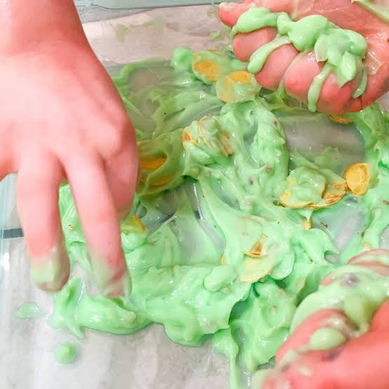
Fun Sensory Activities
FLOUR PASTE
• 1 cup flour (You can add more if needed)
•half a cup water (Add more if needed)
• a drop of food colouring
Combine all the ingredients together to form a paste, let the kids get messy
Watch my video on how to make the flour paste , for the sensory acivity.

Slide 11
Weekly Focus
Learning about a Circle and the colour Red
Learning the number 9
Learning the letter 'S' for Sammy Snake
Press play to see videos for our weekly focus area

Slide 12
Recap on our Weekly focus
Press play to recap on our weekly focus

Slide 13
Extra’s
Sammy Snake letter S:
https://www.google.com/search?q=sammy+snake+letter+land&oq=sammy+snake+letter+land&aqs=chrome..69i57j46j0.5628j0j9&client=tablet-android-samsung&sourceid=chrome-mobile&ie=UTF-8
Learning the Colour Red:
https://youtu.be/uGb0-BLEDWE
Circle video:
https://www.youtube.com/watch?v=YRWbpsREIVU&app=desktop
Number 9 video:
https://www.youtube.com/watch?v=Gk0H2sHo6kU&app=desktop
Highlight, copy and paste the links in your browser tab and watch some interesting videos

