Slide 1
MOTHER’S DAY
Little Lambs

Slide 2
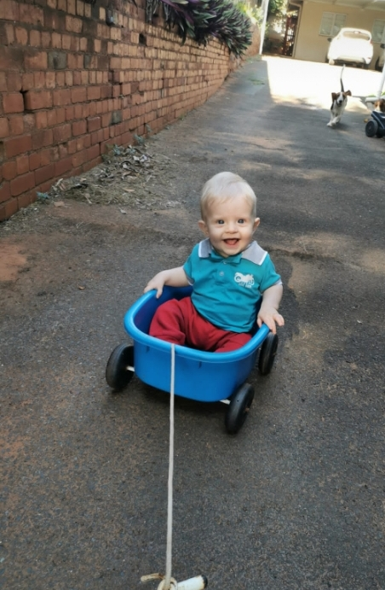
Damon
“Mothers hold their children's hands for a short while, but their hearts forever.”

Slide 3
Madison
“A mother is who can take the place of all others but whose place no one else can take.”

Slide 4
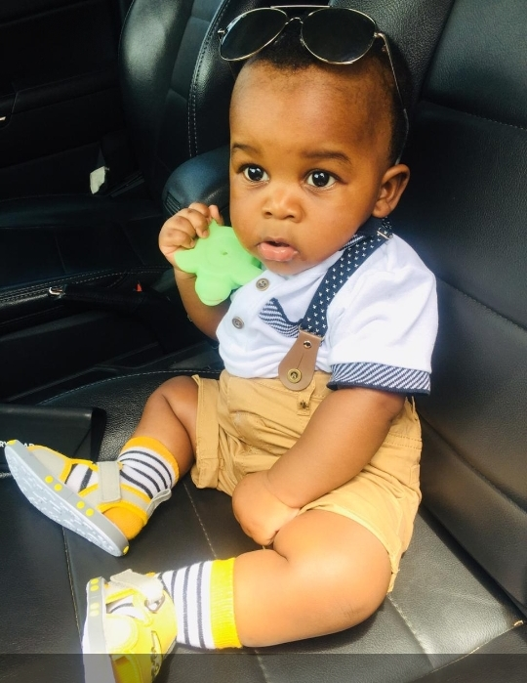
“Moms are the people who know us the best and love us the most.”
Tetelo

Slide 5
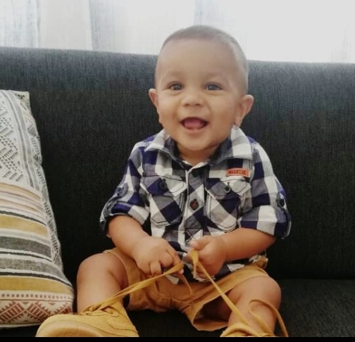
“If you’re a mom, you’re a superhero. Period.”
Zavian

Slide 9
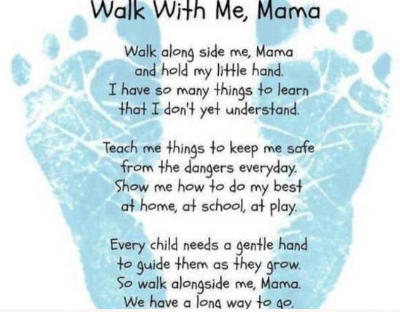

Slide 10
Songs:
https://www.youtube.com/embed/RQ-h6WCVm6Q
https://www.youtube.com/embed/qdiVaBPSwa8
https://www.youtube.com/embed/VpFIUk6BNwA

